Slide 1

MAKING YOUR HOME GREEN Keith Harrison

Slide 2


Slide 3
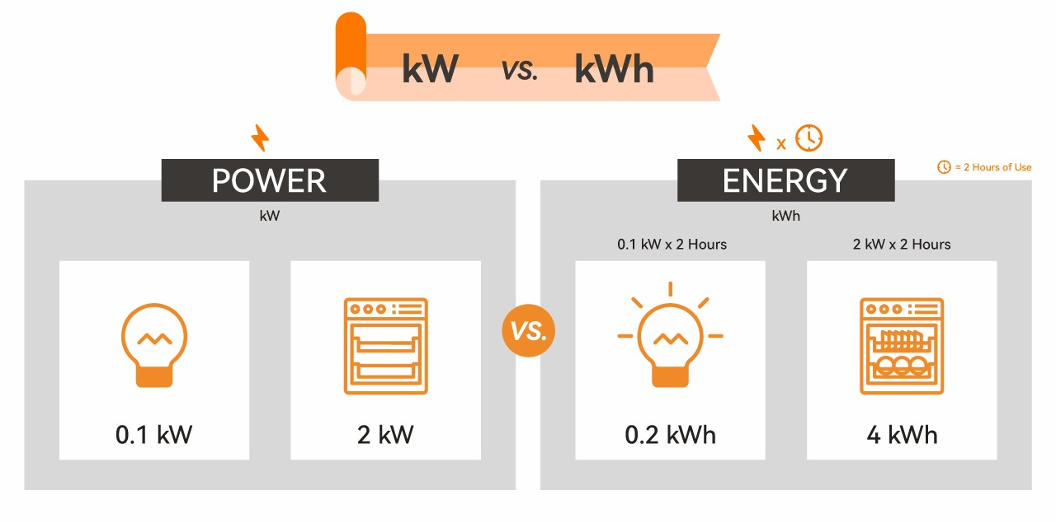

Slide 4
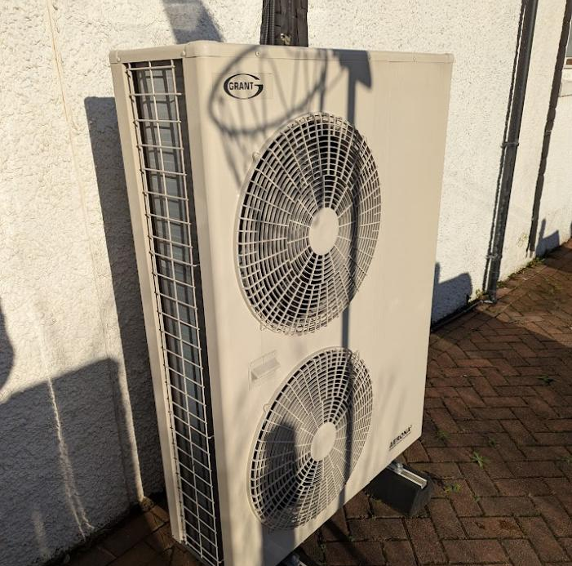
Heat Pump

Slide 5
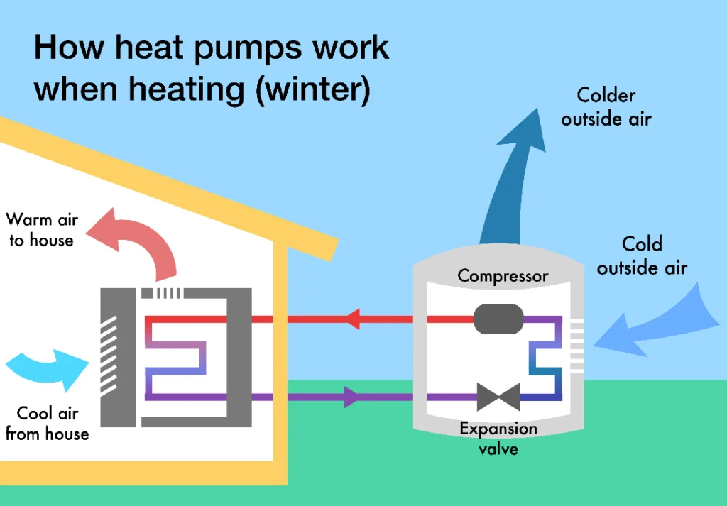

Slide 6
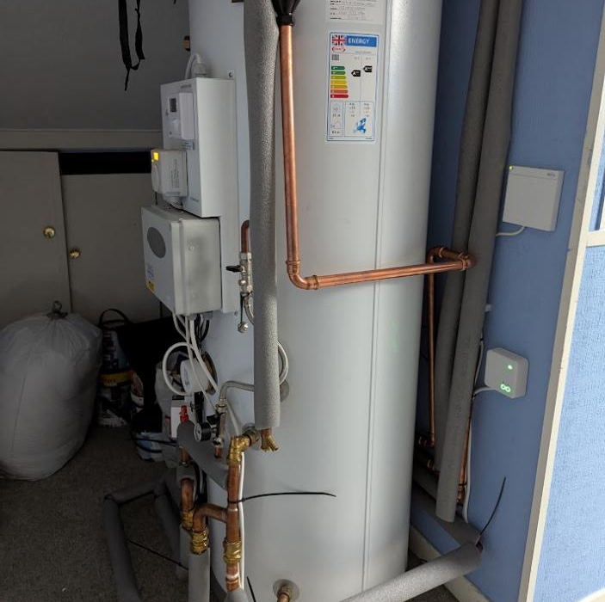
Water Tank

Slide 7
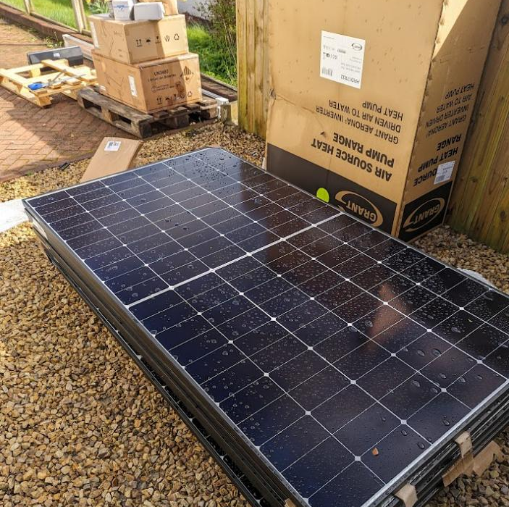
Solar Panels

Slide 8
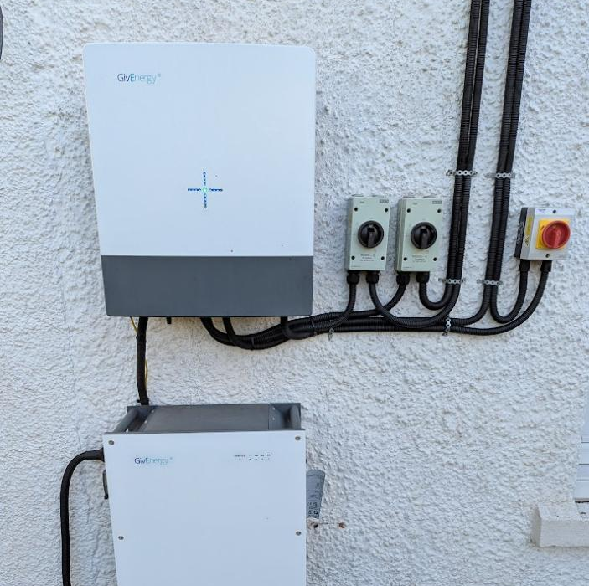
Battery

Slide 9
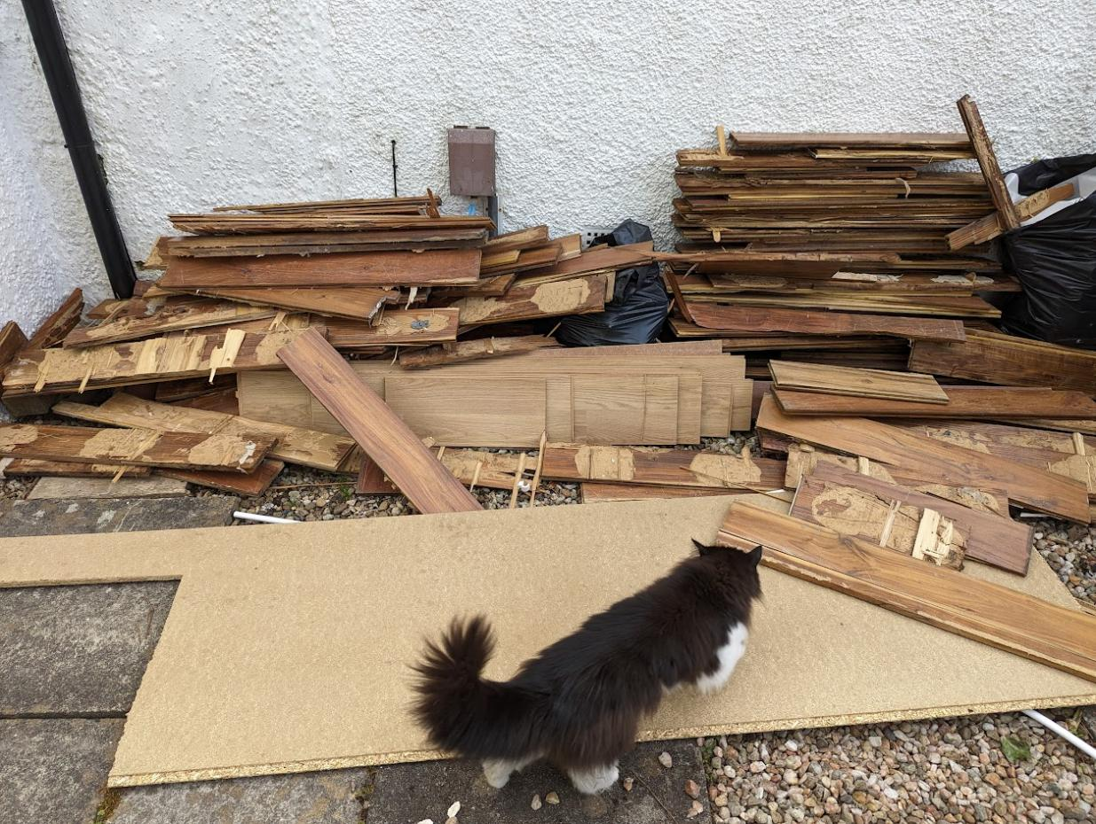
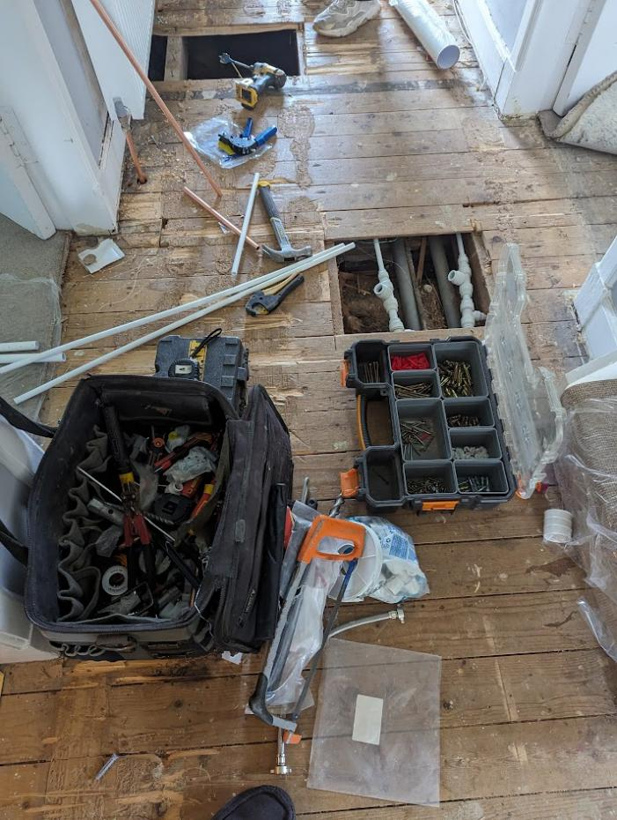
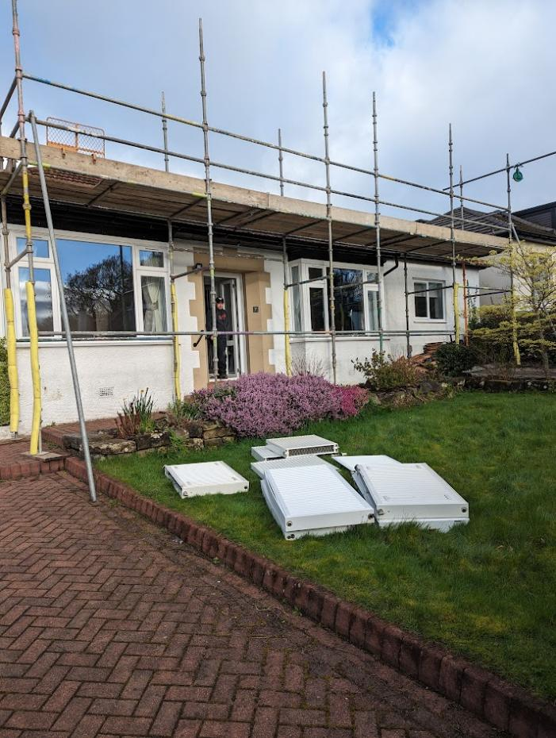
FamilyID=Office_ArchiveTorn
Installation

Slide 10
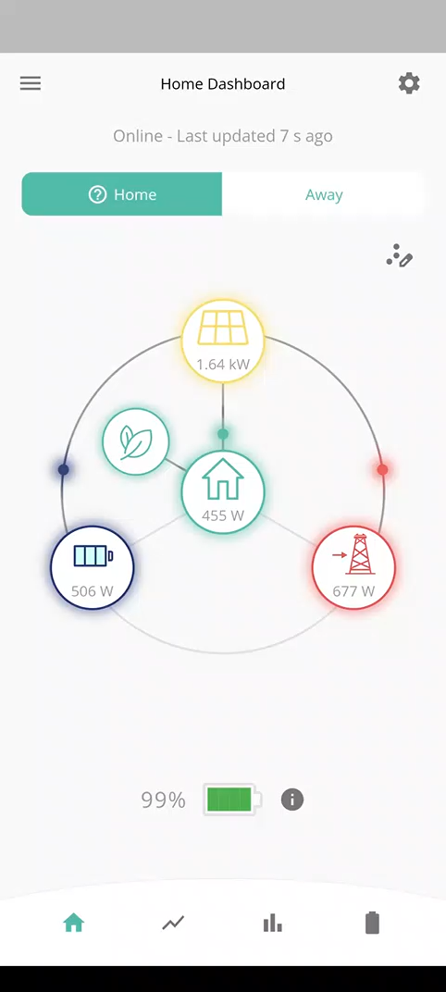

Slide 11
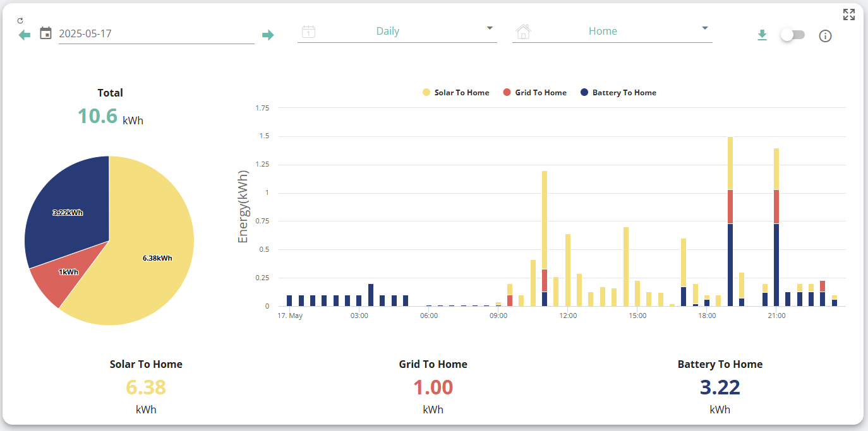

Slide 12
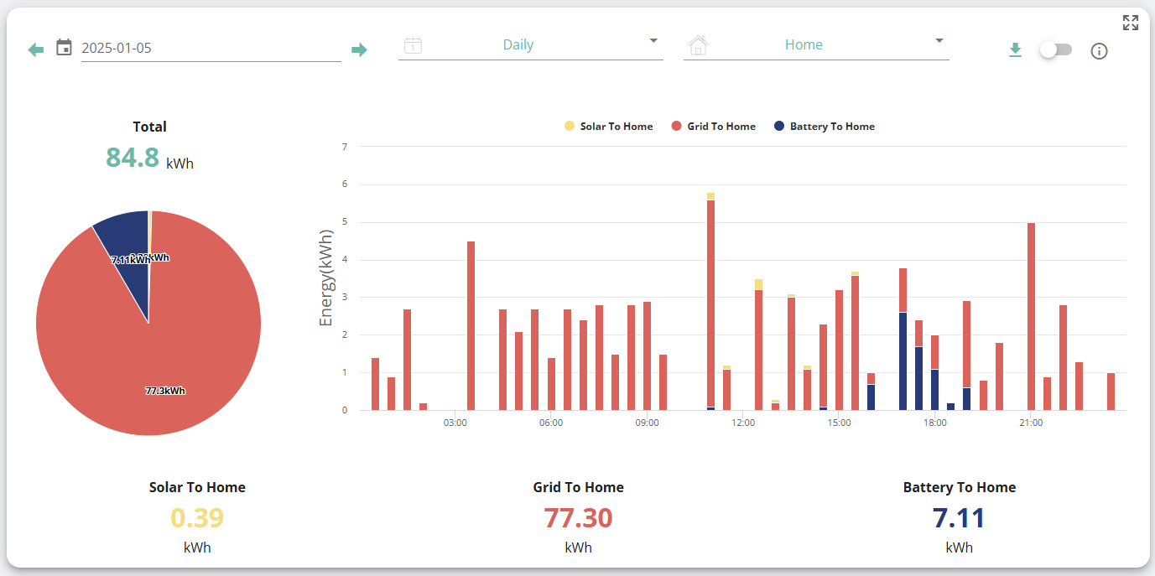

Slide 13
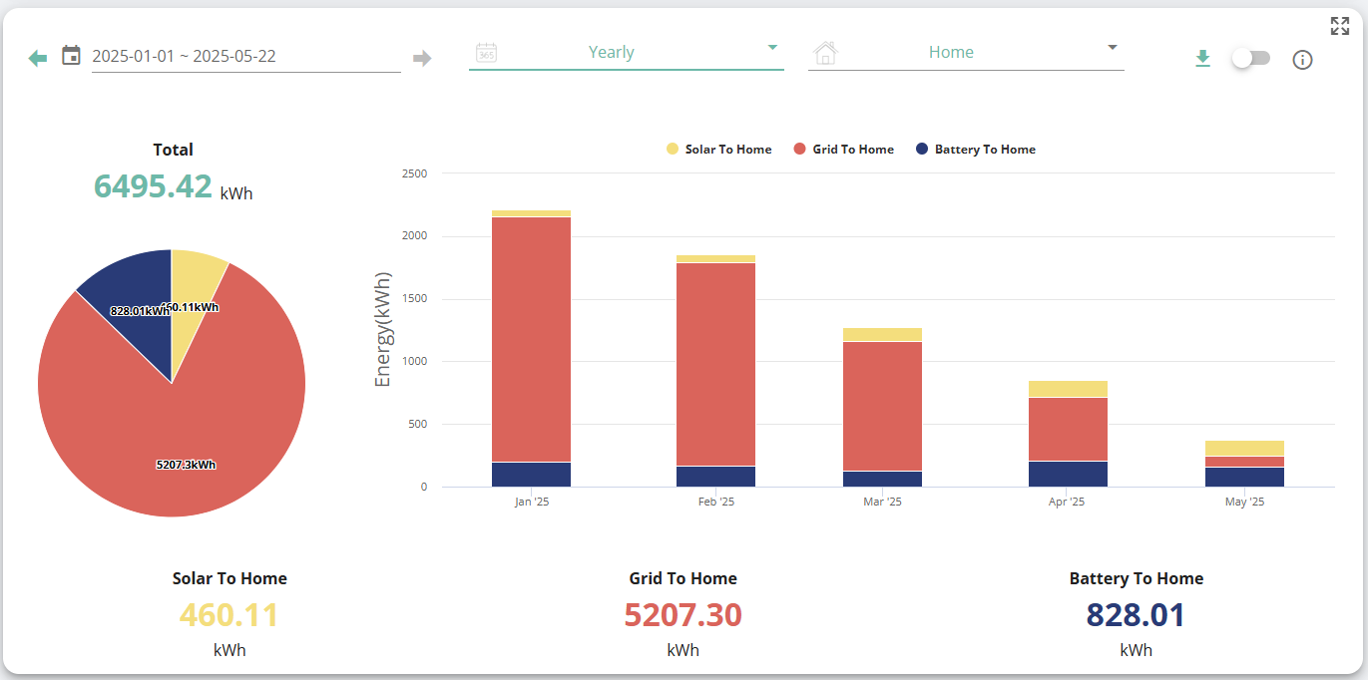

Slide 14
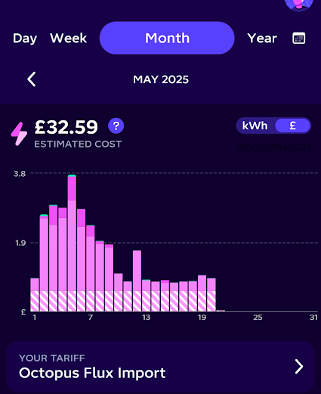
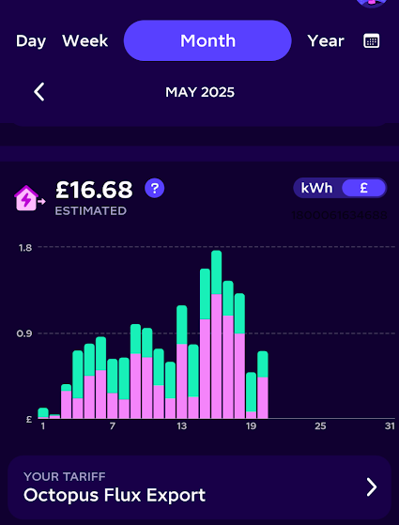

Slide 15

Total Savings
£550

Slide 16
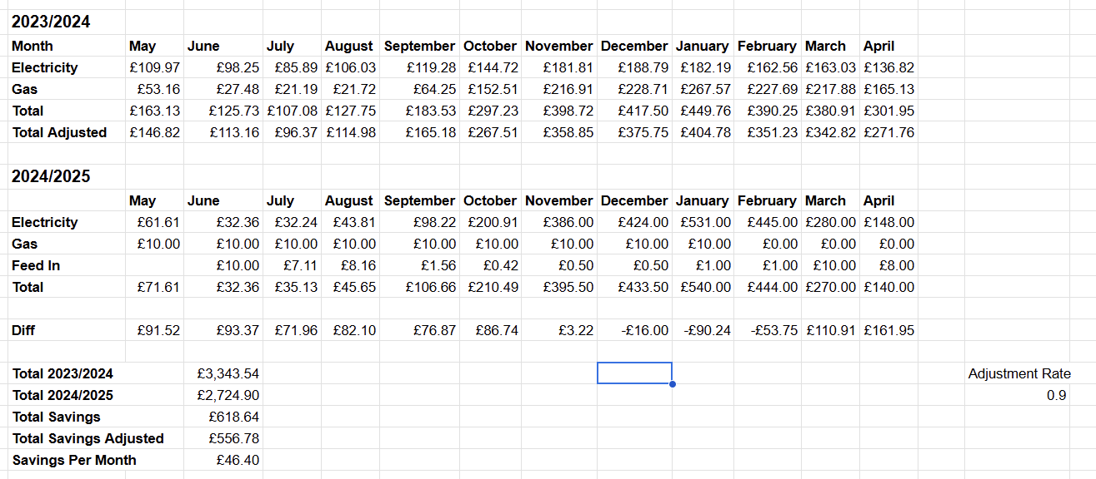

Slide 17
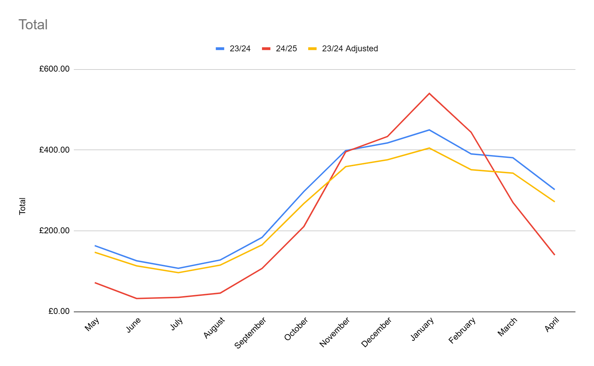

Slide 18
Costs
Item | Amount
Hardware & Installation Costs | £27,000
Preparation Work | £6,000
Total | £33,000
Paid By
Item | Amount
Grant | £10,000
Interest Free Loan | £17,000
Us | £6,000

Slide 19
Break Even
£23,000 / £550 = 46 Years
Excluding New Boiler Costs
£21,500 / £550 = 39 Years

Slide 20
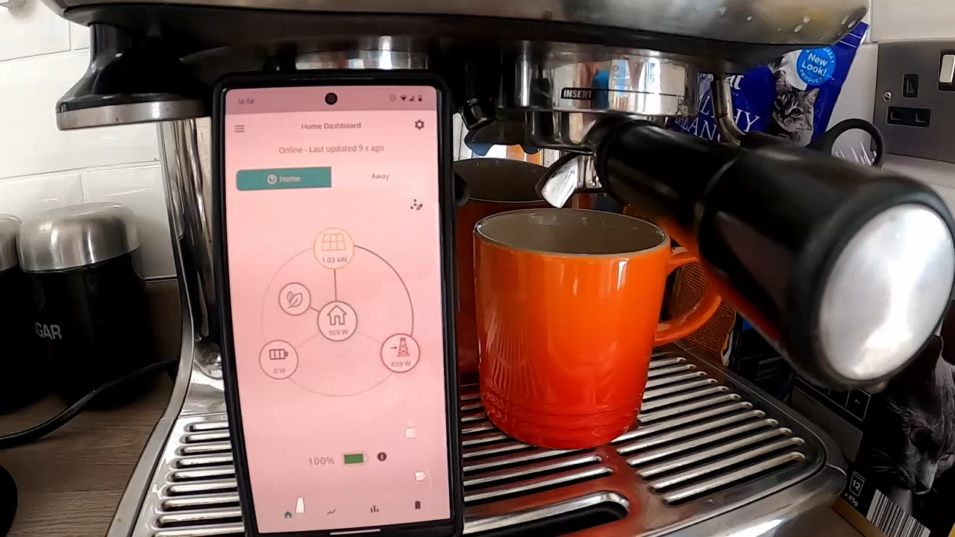

Slide 21

Thank You
Questions?

